Slide 1

Optimization Algorithms
-Theory and Application-
MEHRAN GHANDEHARY
October 8, 2005
Instructor : Dr Samadzadegan
University of Tehran

Slide 2
Contents
I
1. Introduction
Om
2. Optimization Methods
Oa
3. Optimization Algorithms
A
4. Applications
C
5. Conclusion
R
6. Refrence

Slide 3
1. Introduction
I
I
1.1. Problem Statement
Om
1.2. Mathematical Definition
Oa
1.3. Problems in Optimization
A
C
R

Slide 4
1.1.Problem Statement
What is an optimum?
optimization is about finding the best possible solutions for given problems
The problem is :
  to search for the values of the decision variables that minimize or maximize the objective functions while satisfying the constraints
I
I
Om
Oa
A
C
R

Slide 5
Problem Statement (Cont.)
3 basic ingredients…
  a set of objective functions,
  a set of unknowns or variables,
  A set of constraints,
Single Objective Functions :
In the case of optimizing a single criterion f, an optimum is either its maximum or minimum
Multiple Objective Functions :
Global optimization techniques are not just used for finding the maxima or minima of single functions f. In many real-world design or decision making problems, they are rather applied to sets F
I
I
Om
Oa
A
C
R

Slide 6
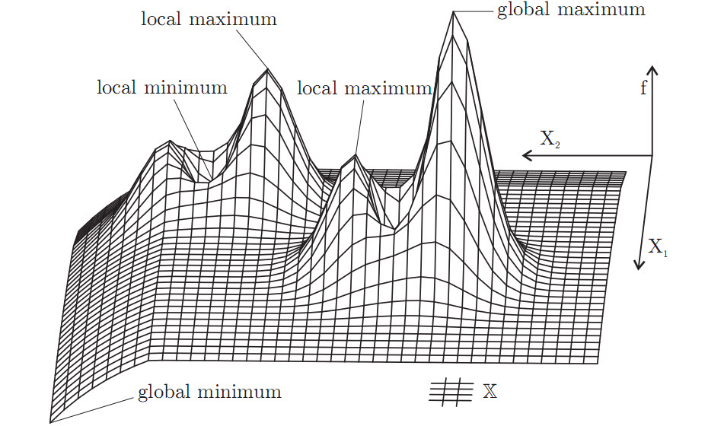
...Single Objective Functions
I
I
Om
Oa
A
C
R

Slide 7
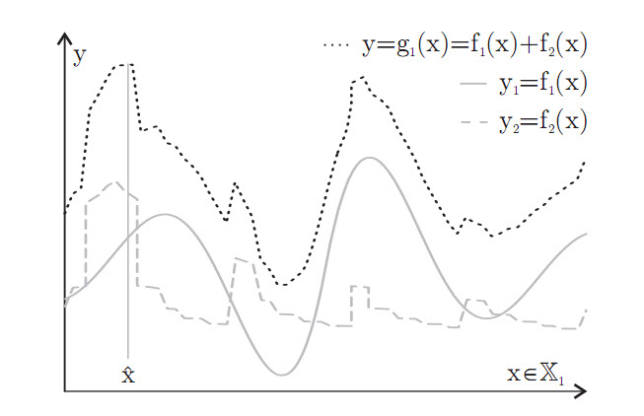
...Multiple Objective Functions
I
I
Om
Oa
A
C
R

Slide 8
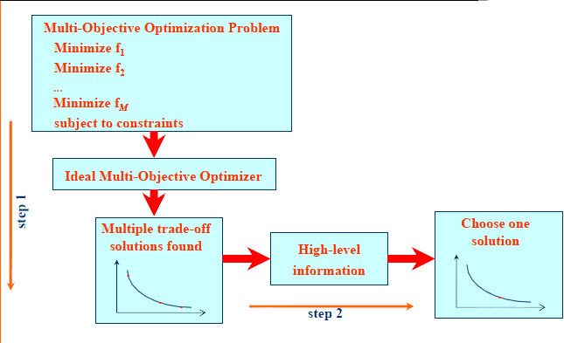
Problem Statement (Cont.)
I
I
Om
Oa
A
C
R

Slide 9
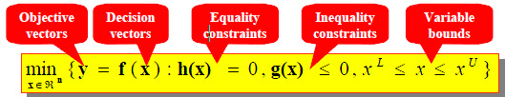
1.2.Mathematical Definition
Mathematical model to formulate the optimization problem
I
I
Om
Oa
A
C
R

Slide 10
1.3.Problems in Optimization
Premature Convergence
Ruggedness and Weak Causality
Deceptiveness
Neutrality and Redundancy
Epistasis
Noise and Robustness
Overfitting and Oversimplification
Dynamically Changing Fitness Landscape
The No Free Lunch Theorem
I
I
Om
Oa
A
C
R

Slide 11
2. Optimization Methods
I
2.1. Optimization Method Classes
Om
2.2. A Classification of Optimization Methods
Oa
2.3. Disadvantages of Classical Methods
A
2.4. Numerical Methods of Optimization
C
2.5. Advanced Optimization Techniques
R

Slide 12
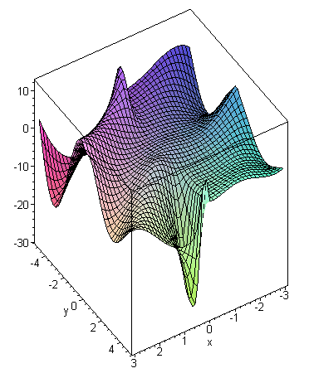
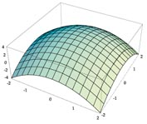
2.1.Optimization Method Classes
unconstrained methods,
constrained methods,
multi-objective optimization methods
multi-solution (niching) methods
dynamic methods
I
Om
Oa
A
C
R

Slide 13
2.2.A Classification of Optimization Methodes
Classification According to Method of Operation
Deterministic algorithms
probabilistic algorithms
Classification According to Properties
Speed and precision
(Online Optimization). Online optimization problems are tasks that need to be solved quickly in a time span between ten milliseconds to a few minutes.
(Offline Optimization). In offline optimization problems, time is not so important and a user is willing to wait maybe even days if she can get an optimal or close to-optimal result.
I
Om
Oa
A
C
R

Slide 14
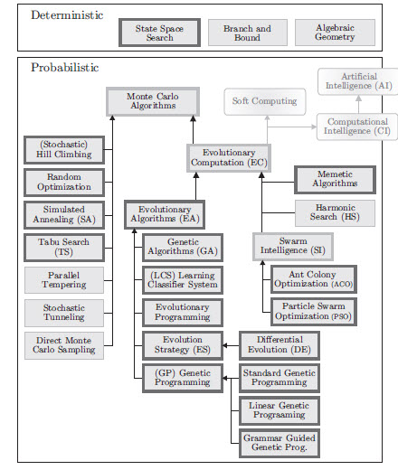
…Classification According to Method of Operation
I
Om
Oa
A
C
R

Slide 15
Classification of Optimization Algorithms (cont.)
Optimization problems are classified based on a number of characteristics :
  The number of variables
  The type of variables
  The degree of nonlinearity of the objective function
  The constraints used
  The number of optima
  The number of optimization criteria
I
Om
Oa
A
C
R

Slide 16
2.3.Disadvantages of Classical Methods
We need prior knowledge of the problem domain to result in to a single objective optimization problem (e.g., weight vector, ε constraints)
Results in a single solution for each run
Require fitness function to be linear, continuous and differentiable
The classical optimization techniques are useful in finding the optimum solution or unconstrained maxima or minima of continuous and differentiable functions.
I
Om
Oa
A
C
R

Slide 17
2.4.Numerical Methods of Optimization
Linear programming
Integer programming
Quadratic programming
Nonlinear programming:
Stochastic programming
Dynamic programming
Combinatorial optimization
Infinite-dimensional optimization
Constraint satisfaction
I
Om
Oa
A
C
R

Slide 18
2.5.Advanced Optimization Techniques
Hill climbing
Ant colony optimization
Evolutionary Algorithms
Genetic algorithms
Simulated Annealing
Tabu search
I
Om
Oa
A
C
R

Slide 19
3. Optimization Algorithms
I
3.1. General Local Search Procedure
Om
3.2. Hill Climbing
Oa
3.3. Simulated Annealing
A
3.4. Tabu Search
C
R

Slide 20
3.1. General Local Search Procedure
In many optimization problems, the path to the goal is irrelevant; the goal state itself is the solution, such as 8 queens problem
State space = set of "complete" configurations
Find configuration satisfying constraints, e.g., n-queens
In such cases, we can use local search algorithms
keep a single "current" state, try to improve it
I
Om
Oa
A
C
R

Slide 21
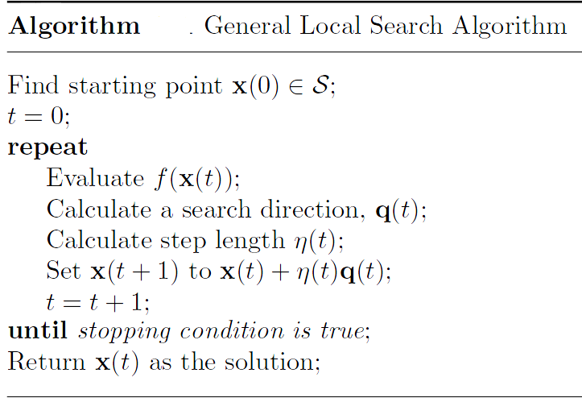
General Local Search Procedure (cont.)
I
Om
Oa
A
C
R

Slide 22

General Local Search Procedure (cont.)
Example :
Put n queens on an n × n board with no two queens on the same row, column, or diagonal
I
Om
Oa
A
C
R

Slide 23
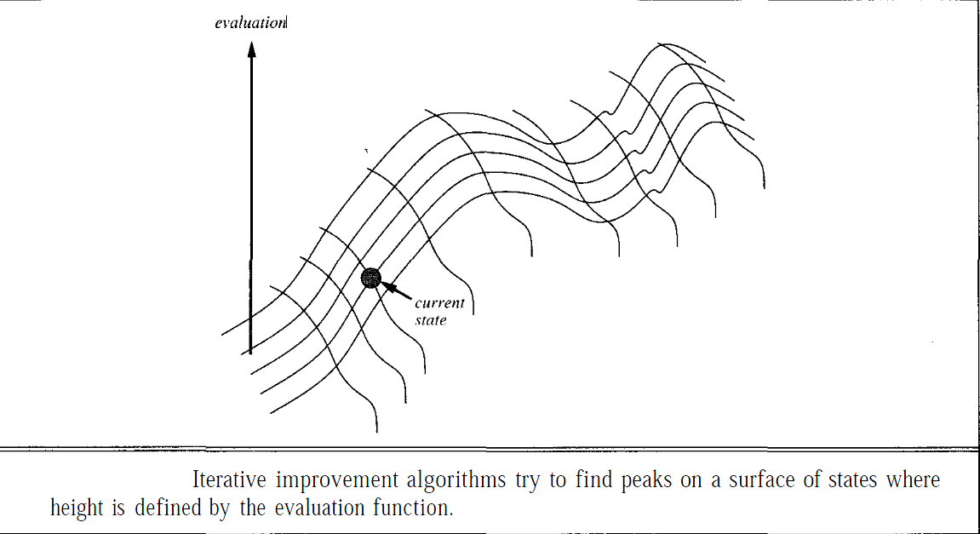
General Local Search Procedure (cont.)
I
Om
Oa
A
C
R

Slide 24
3.2.Hill climbing
Hill climbing: it is a graph search algorithm where the current path is extended with a successor node which is closer to the solution than the end of the current path.
In simple hill climbing, the first closer node is chosen whereas in steepest ascent hill climbingall successors are compared and the closest to the solution is chosen. Both forms fail if there is no closer node. This may happen if there are local maxima in the search space which are not solutions.
Hill climbing is used widely in artificial intelligence fields, for reaching a goal state from a starting node. Choice of next node/ starting node can be varied to give a number of related algorithms.
I
Om
Oa
A
C
R

Slide 25

Hill climbing ( cont .)
I
Om
Oa
A
C
R

Slide 26

Hill climbing ( cont .)
Problem: depending on initial state, can get stuck in local maxima
I
Om
Oa
A
C
R

Slide 27
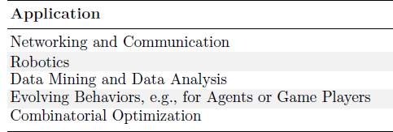
Hill climbing ( cont .)
I
Om
Oa
A
C
R

Slide 28

Hill climbing ( cont .)
Hill-climbing search: 8-queens problem
I
Om
Oa
A
C
h = number of pairs of queens that are attacking each other, either directly or indirectly
A local minimum with h = 1
R

Slide 29
3.3.Simulated annealing
The name and inspiration come from annealing process in metallurgy, a technique involving heating and controlled coolingof a material to increase the size of its crystals and reduce their defects.
The heat causes the atoms to become unstuck from their initial positions (a local minimum of the internal energy) and wander randomly through states of higher energy;
the slow cooling gives them more chances of finding configurations with lower internal energy than the initial one.
In the simulated annealing method, each point of the search space is compared to a state of some physical system, and the function be minimized is interpreted as the internal energy of the system in that state. Therefore the goal is to bring the system, from an arbitrary initial state, to a state with the minimum possible energy.
I
Om
Oa
A
C
R

Slide 30
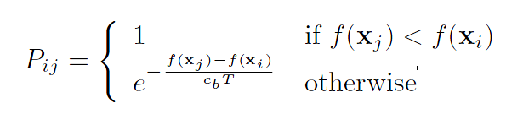
Simulated annealing ( cont . )
a popular local search meta-heuristic
it provides a means to escape local optima by allowing hill-climbing moves
It is typically used to address discrete, and to a lesser extent, continuous optimization problems
The innermost loop of simulated annealing is quite similar to hill climbing.
I
Om
Oa
A
C
R

Slide 31
Simulated annealing ( cont . )
One can prove: If T decreases slowly enough, then simulated annealing search will find a global optimum with probability approach
Widely used in VLSI layout, airline scheduling, etc
I
Om
Oa
A
C
R

Slide 32

Simulated annealing ( cont . )
I
Om
Oa
A
C
R

Slide 33

Simulated annealing ( cont . )
I
Om
Oa
A
C
R

Slide 34
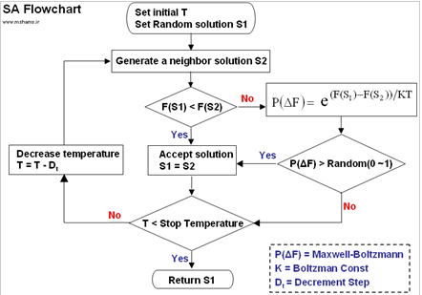
Simulated annealing ( cont . )
I
Om
Oa
A
C
R

Slide 35
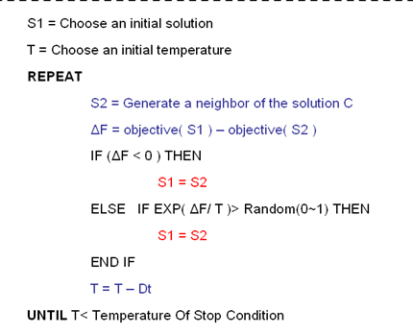
Simulated annealing ( cont . )
I
Om
Oa
A
C
R

Slide 36
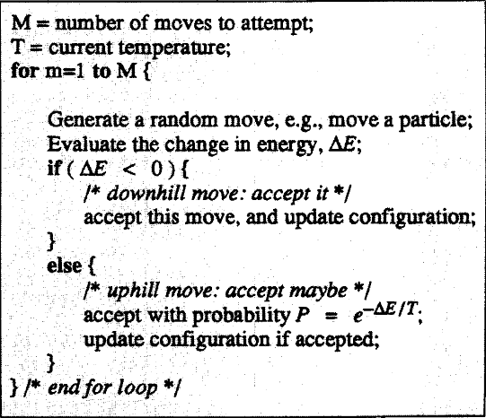
Simulated annealing ( cont . )
I
Om
Oa
A
C
R

Slide 37
3.4.Tabu search
Is a meta-heuristic approach
Tabu search has important links to evolutionary and “genetic” methods
Faced with the challenge of solving hard optimization problems
I
Om
Oa
A
C
R

Slide 38
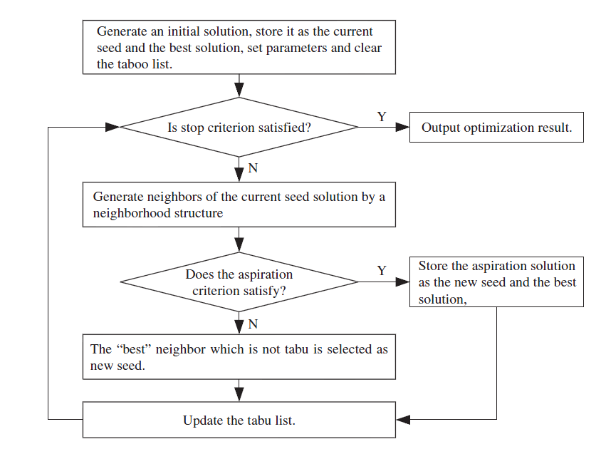
Generic flowchart of tabu search algorithm
I
Om
Oa
A
C
R

Slide 39
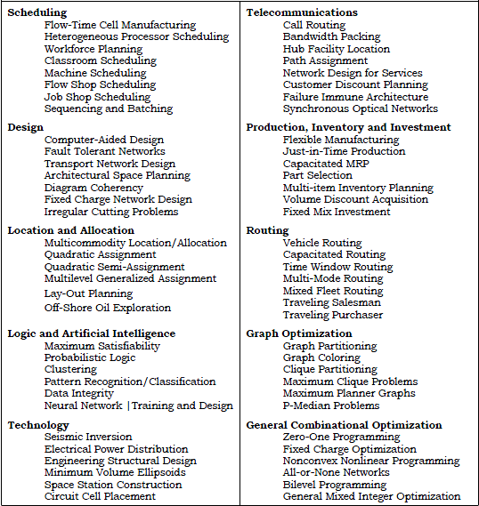
Tabu search application
applications
I
Om
Oa
A
C
R

Slide 40
4. Application
4.1. General application
I
4.2. application in GIS
Om
Oa
A
C
R

Slide 41
4.1.General Application
In real life environments we always strive to optimize a number of parameters in any design and these parameters are usually highly correlated. Hence, some tradeoff between the criteria is needed to ensure a satisfactory design. For examples, …
In bridge construction, a good design is characterized by low total mass and high stiffness.
Aircraft design requires simultaneous optimization of fuel efficiency, payload, and weight.
A good sunroof design in a sports car could aim to minimize the noise the driver hears and maximize the ventilation.
I
Om
Oa
A
C
R

Slide 42
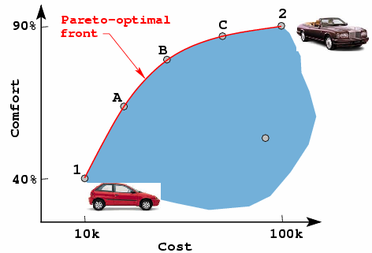
…Buying an Automobile
Objective = reduce cost, while maximize comfort
Which solution (1, A, B, C, 2) is best ???
No solution from this set makes both objectives look better than any other solution from the set.
No single optimal solution
Trade off between conflicting objectives-cost and comfort
I
Om
Oa
A
C
R

Slide 43
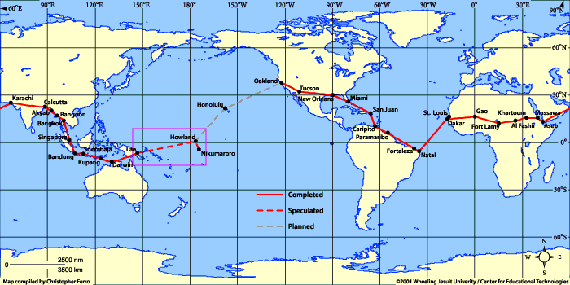
…Scheduling of Flight Routes
I
Om
Oa
A
C
a cheaper but inconvenient flight vs.
a convenient but expensive flight
R

Slide 44
4.2.Application in GIS
Computational Intelligence Algorithms for Optimized Vehicle Routing Applications in Geographic Information Systems
Decision Support Systems
multiple criterion decision making (MCDM)
Incorporate Intelligent Computation into Coverage Optimization for Networks
Shortest path selection
I
Om
Oa
A
C
R

Slide 45
Conclusion
optimization is about finding the best possible solutions for given problems
Hill climbing depending on initial state, can get stuck in local maxima
Simulated annealing it provides a means to escape local optima by allowing hill-climbing moves

Slide 46



REFRENCES
Global Optimization Algorithms (Global Optimization Algorithms) , Thomas Weise , Version: 2009-06-26
Presenting a Search Algorithm Based on Population-based Methods in Combinatorial Optimization , kheirkhah
Multiobjective Optimization Problems , http://www.lania.mx/~ccoello/EMMO/
Multiobjective optimization problems , Clasical and Advance techniquse for optimization , D Nagesh Kumar, IISc
http://en.wikipedia.org/wiki/HillClimbing
http://en.wikipedia.org/wiki/Tabu Search
http://iridia.ulb.ac.be/~mdorigo/ACO/ACO.html
http://www.scribd.com
http://www.scribd.com/doc/4707425/Ant-Colony-Optimisation-Project-Description

Slide 47


Questions ?
Comments
Instructor : Dr Samadzadegan

